Slide 1

Humanitarian Response Tracking System
Biju Ale
L4DC Office Solutions Development (OSD) Project
Softwarica College of IT & E-Commerce
Kathmandu, Nepal
Sep 08, 2016

Slide 2
Presentation overview
Background.
Aims & objectives.
Project plan with Gantt chart.
Implementation details.
Future works
Lessons learnt

Slide 3
Background
The onset of major disaster or crisis in a country immediately triggers a humanitarian response by international communities.
Example: Nepal earthquake 2015 responded by Save The Children, Oxfam, Dan Church Aid, UN OCHA…

Slide 4
…Background
Humanitarian agencies need to plan, execute, & monitor emergency project.
My system is designed to help them
plan the logical framework during onset of crisis &
track the response details as project executes.

Slide 5
Aim
To build desktop application for humanitarian agency responding to disaster/crisis so that they can track their response
To aid the agency in planning and M&E.

Slide 6
Objectives
To provide authentication & security via user-type based login system.
To allow the agency to set & modify targets/indicators for each clusters.
To provide filtration based search facility on relevant forms.
To enable generation of reports for log frame, & activity details.
To aid the end-user in export & backup of file.

Slide 7
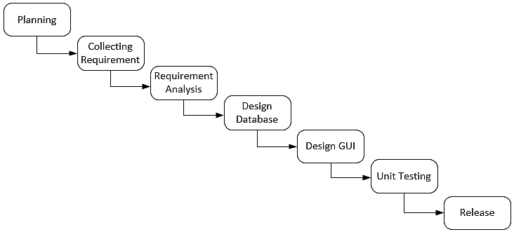
Project plan
Development Method

Slide 8
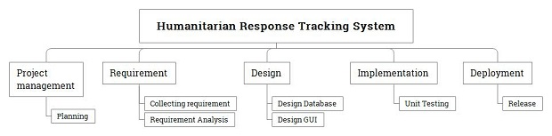
…Project plan
Work breakdown structure

Slide 9
…Project plan
Time taken

Slide 10
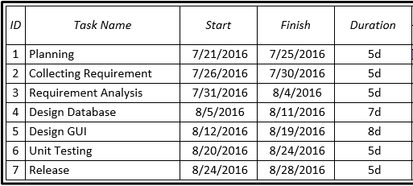
Gantt chart
chart 1 of 2

Slide 11
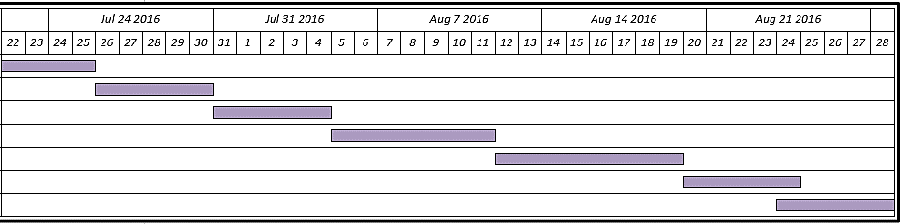
...Gantt chart
chart 2 of 2

Slide 12
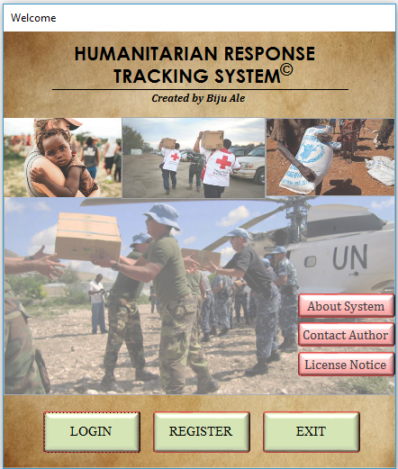
Implementation details

Slide 13
Authentication User types & privileges
Activate / Deactivate users
SUPER ADMINISTRATOR
Add new staff
Restore backup
Append project cluster
Full CRUD ability
ADMINISTRATOR
GENERAL USER
CRUD on staff
view staff details
Register user
Backup
CRU on LogFrame
Export database
Set autobackup
View activities’ report
CRU on Activities

Slide 14
Authentication Authorized login
Only agency personnel with staff ID are able to register as user.
Only registered & activated account can use the system.
Only Super Admin can activate registered accounts

Slide 15
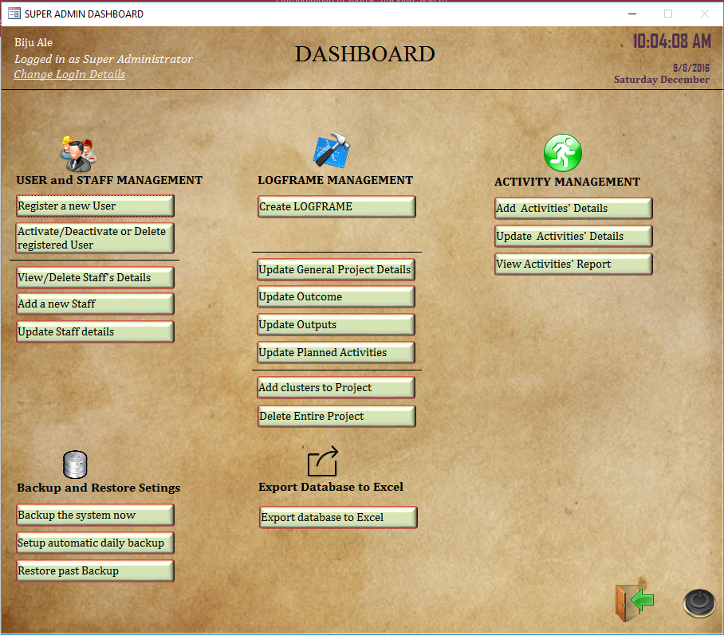
Dashboard 3 dashboards for 3 user types

Slide 16
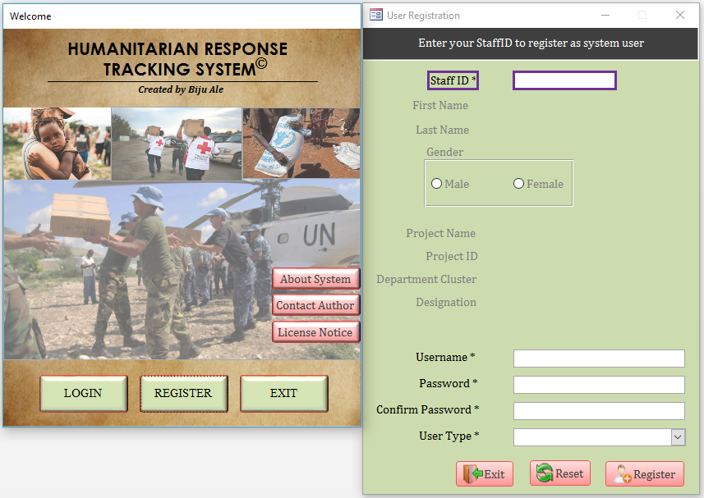
User and Staff Management Register a user

Slide 17
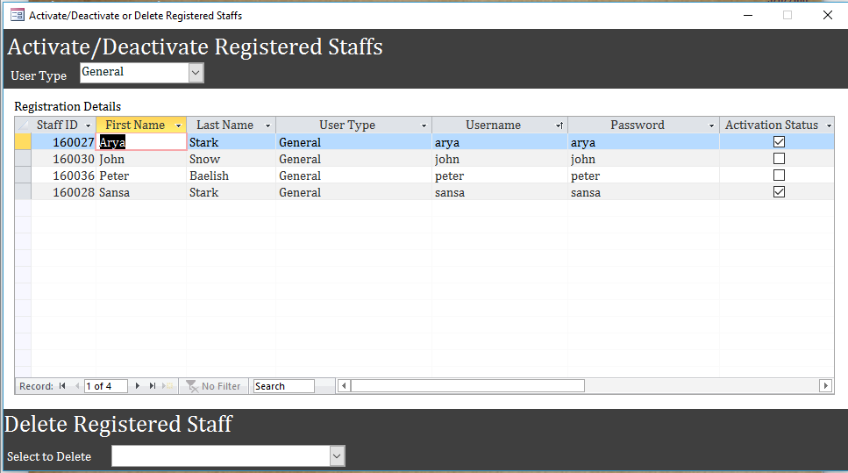
User and Staff Management activate/deactivate/ delete registered user

Slide 18
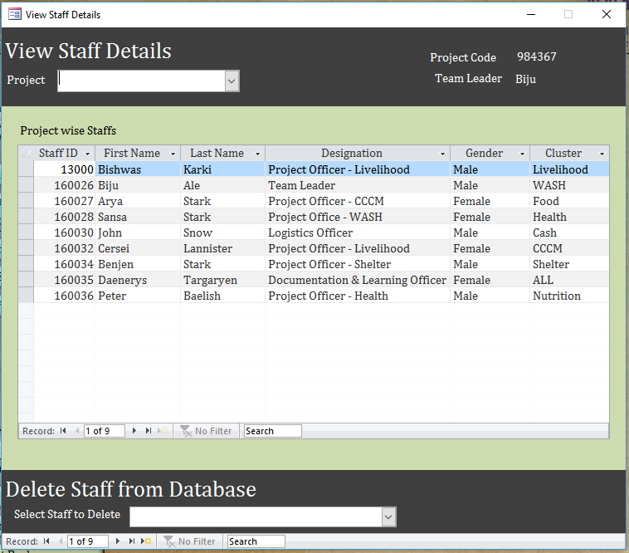
User and Staff Management view / delete staff details

Slide 19
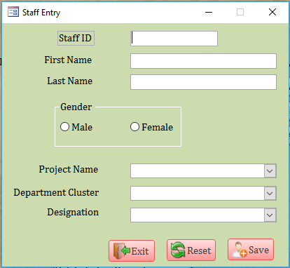
User and Staff Management add staff details

Slide 20
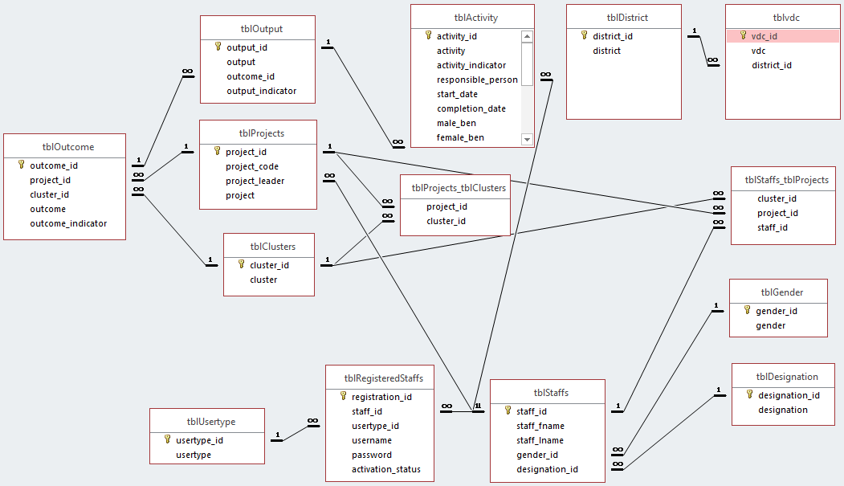
Logframe management Entity relationship

Slide 21
Logframe management Entity relationship simplified
Activity A
Output A
Outcome A
Output B
Activity B
Cluster A
Activity C
Outcome B
Output C
Project
Activity D
Output D
Outcome C
Output E
Activity E
Cluster B
Activity F
Outcome D
Output F
Activity G
Example of an instance

Slide 22
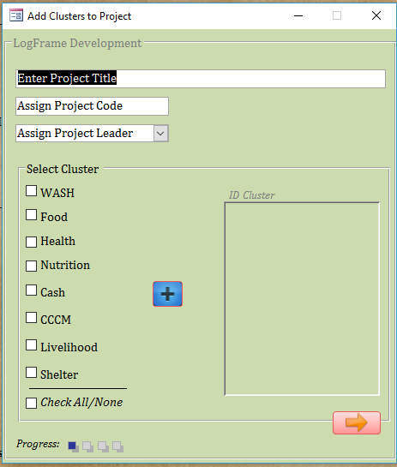
Logframe management create LOGFRAME
Progress 1 of 4: Add clusters to Project

Slide 23
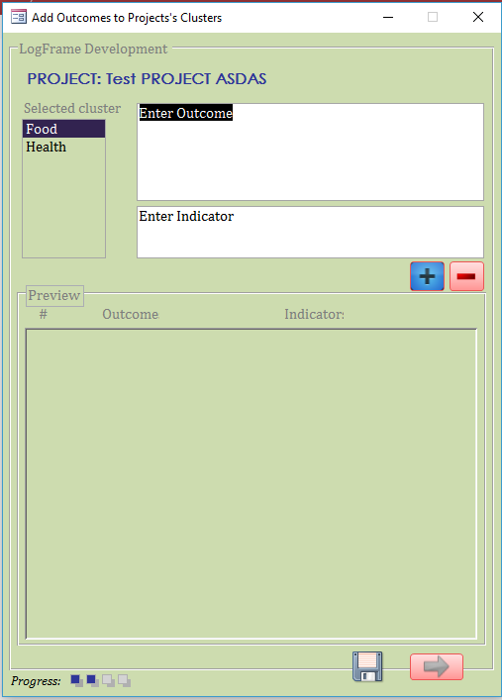
Logframe management …create LOGFRAME
Progress 2 of 3: Add outcomes to clusters

Slide 24
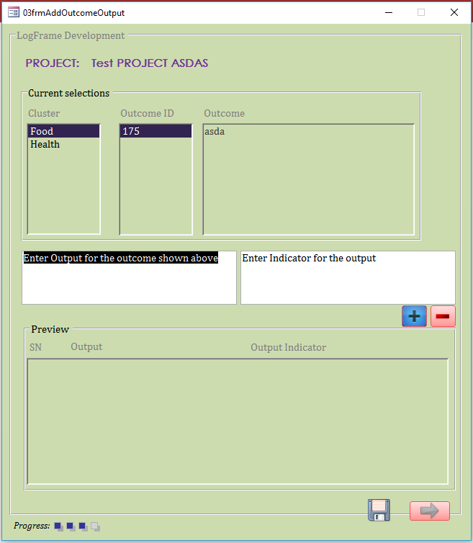
Logframe management …create LOGFRAME
Progress 3 of 4: Add outputs to outcomes

Slide 25
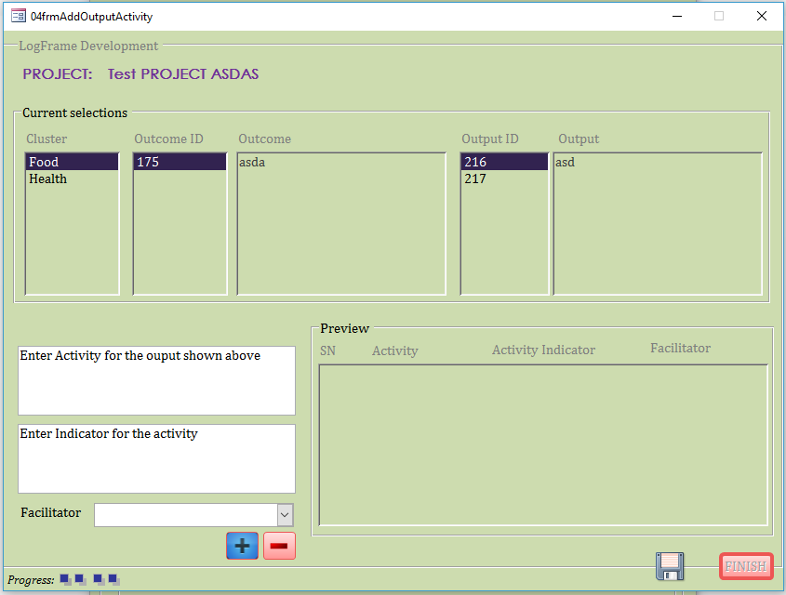
Logframe management …create LOGFRAME
Progress 4 of 4: Add activities to outputs

Slide 26
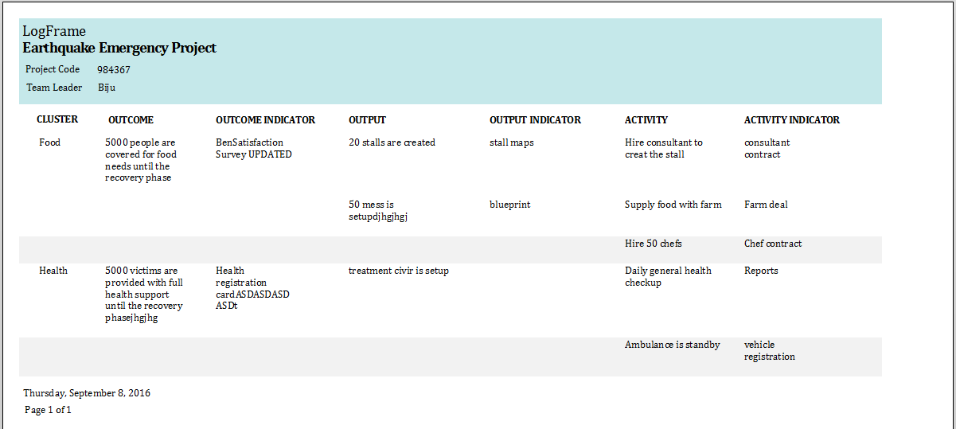
Logframe management Report
View LogFrame

Slide 27
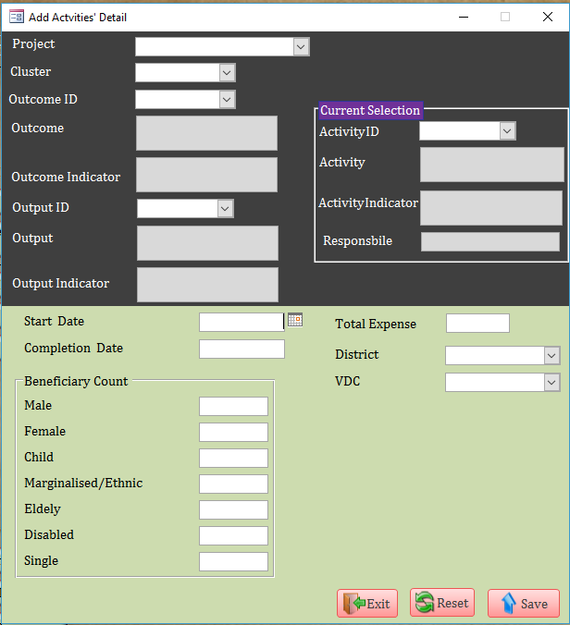
Activities management Add details to planned activities

Slide 28
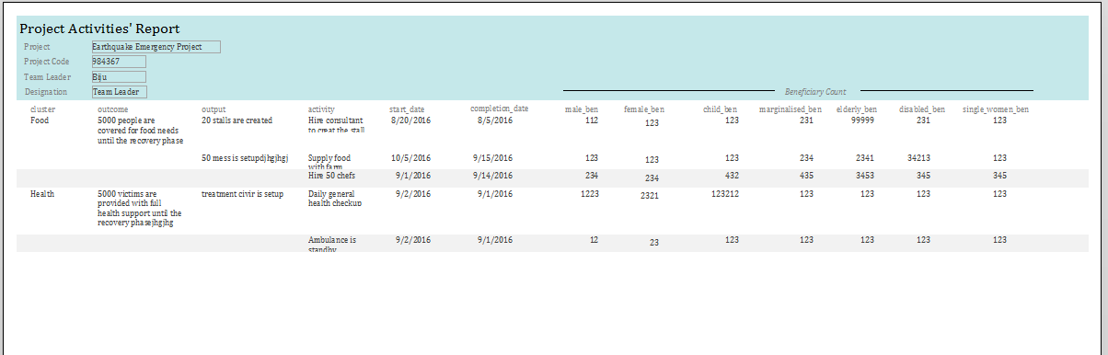
Activities management Activities’ report

Slide 29
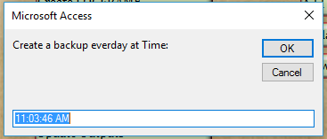
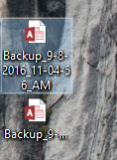
Backup & restore settings Backup now, scheduled backup, restore

Slide 30
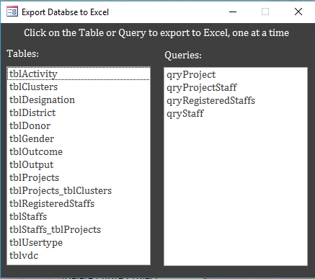
Export database to Excel

Slide 31
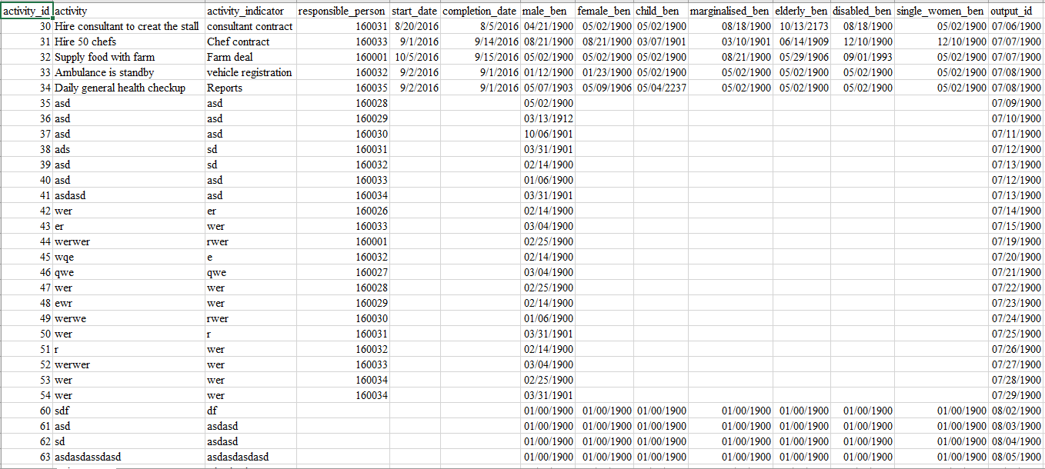
…Export database to Excel
Example of export (Activity details)

Slide 32
Reflection & Learning
Access is a feature-rich & powerful end-user application.
Research is the key to success.
Create many save-points & backup frequently

Slide 33
Future Works
User activity logs
Password encryption
…

Slide 34
Conclusion
I have developed the System for international agencies responding to disaster.
With aim to help them in in house information management, planning & M&E.
I hope the system will, in the long run, contribute in the humanitarian domain.

Slide 35
END

